Slide 1


RTL& full flow to GDSII| TSMC 65nm
Spline Interpolation DSP ASIC
Project No. 3439
Maria Najjar | Malak Khaskia
Advisor: Mohammad Khamaysi
Tel Aviv University · Faculty of Engineering Final Project Presentation , 2026

Slide 2
Project Overview
Programmable 64-QAM I/Q interpolation ASIC — from MATLAB model to routed TSMC 65 nm implementation
WHY?
HOW?
Motivation
Solution
QAM baseband streams must be up-sampled to interface with faster DSP blocks and high-rate DACs
New samples must be generated between the original I/Q samples while preserving waveform accuracy and keeping the I and Q channels synchronized.
The quality of the interpolation directly affects the reconstructed waveform and the resulting EVM.
Increasing the sample rate also introduces spectral images, which must be suppressed before the signal is delivered to the output
DSP ASIC performing Spline interpolation of 64-QAM signals
Configurable L = 2, 3, 4, 5: 60 MSa/s input → 120 / 180 / 240 / 300 MSa/s output
Follow the interpolator with a programmable 10-tap FIR low-pass filter to suppress spectral images.
Implemented in TSMC 65 nm through the complete RTL-to-GDSII flow
.
ASIC
solution
Core signal-processing flow
64-QAM I/Q
Spline
FIR
High-rate I/Q
60 MSa/s input
interpolation
image suppression
120–300 MSa/s output
Goal: real-time, low-EVM, synchronized I/Q interpolation with full RTL-to-layout validation.

Slide 3
Project Requirements & Deliverables
What the ASIC had to achieve — and what was delivered
64-QAM I/Q • 60 MSa/s input • Programmable L = 2,3,4,5 • TSMC 65 nm
Quantitative targets
EVM < 350 m%rms (64-QAM signal-quality target ).
Output rates: 120–300 MSa/s for L = 2,3,4,5
ASIC operating frequency ≥ 100 MHz
ASIC core area ≤ 0.4 mm²
Post-layout timing closure — non-negative setup and hold slack after routing and parasitic extraction.
Project Deliverables
MATLAB floating- and fixed-point models
Synthesizable RTL design
Synthesized gate-level netlist
Final routed ASIC implementation
GDSII layout
Signoff reports
GitHub repository & documentation
Final objective: deliver a verified, programmable spline-interpolation ASIC from MATLAB algorithm to routed 65 nm implementation.

Slide 4
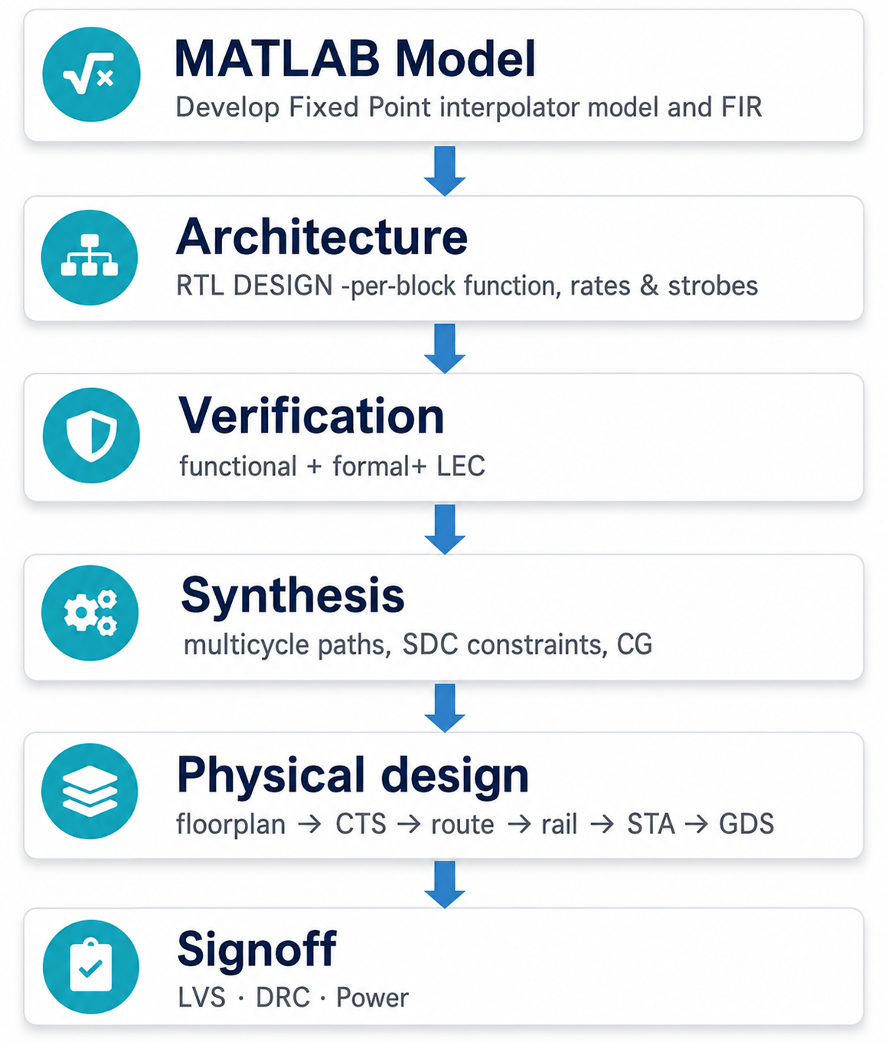
Project Flow
The project was developed through a complete algorithm-to-layout ASIC flow in TSMC 65 nm.
MATLAB Model: algorithm development, floating-/fixed-point modeling, FIR design, and signal-quality analysis.
Architecture: programmable I/Q RTL datapaths with shared control and multi-rate operation.
Verification: simulation, MATLAB golden comparison, SVA, formal verification, and LEC.
Synthesis: timing constraints, multicycle paths, clock gating, and gate-level implementation.
Physical Design: floorplan, power grid, placement, CTS, routing, ECO, and extraction.
Signoff: post-layout STA, power, GLS, DRC/LVS, and final implementation checks.

Slide 5



MATLAB Model Development & Algorithm Selection
MATLAB was used to validate the algorithm, convert it to fixed-point arithmetic, tune the FIR coefficients, and create the RTL golden reference.
MINAJ2 cubic interpolation
Hardware-compatible MATLAB model
Local cubic method using three neighboring samples.
Uses previous slope and calculates a new slope.
Generates L samples for each input interval.
Floating-point model → Fixed-point model → RTL golden vectors
Quantity | Format / Value
Word bits | 16
Fractional bits | 12
Phase | Q1.15
FIR | 10 taps
x[n−1] x[n] x[n+1]
generated samples at phases
$$u_{k}=\frac{k}{L} k=0,1,2,…L−1$$
FIR coefficient selection
$$S_{n}\left(u_{k}\right)=H_{00}\left(u\right)x_{n−1}+H_{01}\left(u\right)x_{n}+H_{10}\left(u\right)m_{n−1}+H_{11}\left(u\right)m_{n}$$
10-taps low-pass FIR designed using MATLAB firpm for low-cost equiripple filtering.
Coefficients optimized for each interpolation factor to preserve the 20 MHz band and suppress images.
Coefficients quantized to signed Q3.12 and validated using EVM, spectrum, and constellation results.
$$m_{n}=\frac{−11x_{n−1}−4m_{n−1 }+8x_{n}+3x_{n+1}}{10}$$
MINAJ2 was selected for cubic-quality interpolation with a local, streaming-friendly hardware implementation, while MATLAB firpm was chosen to obtain an optimal equiripple 10-tap FIR response that suppresses interpolation images with low hardware cost.

Slide 6

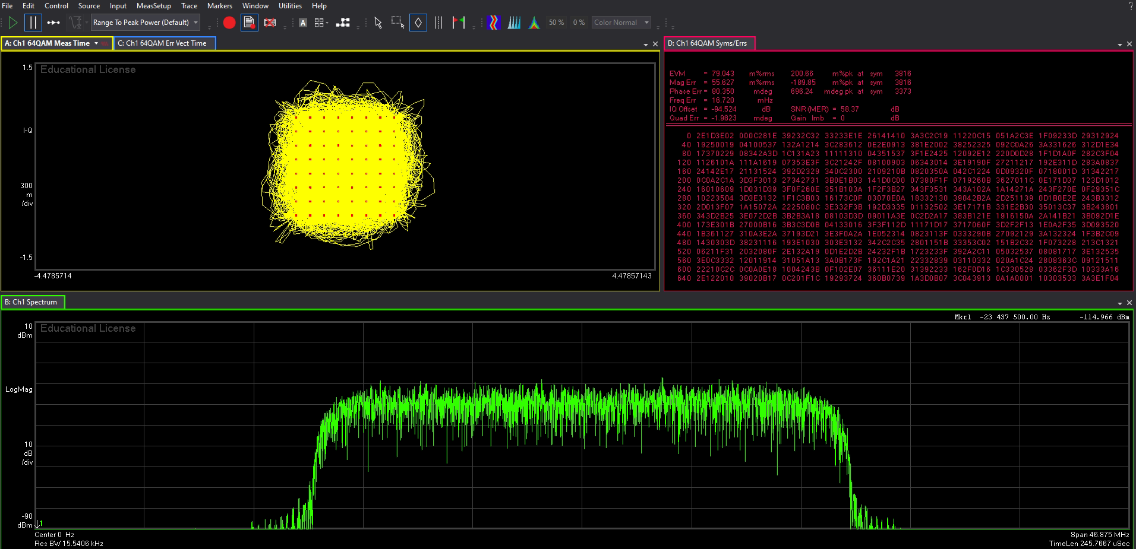
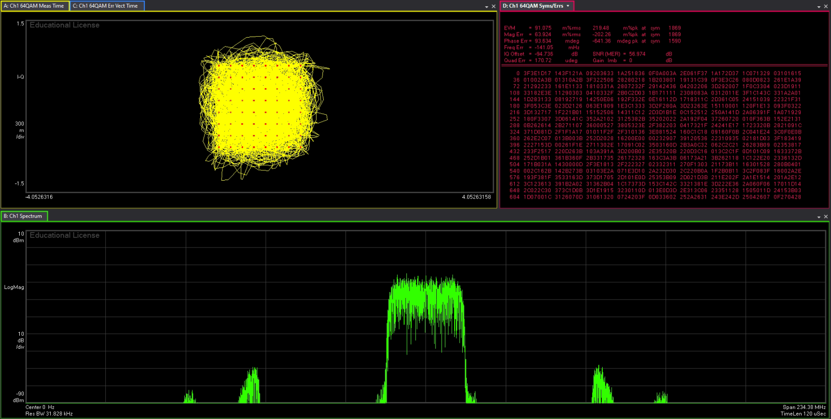
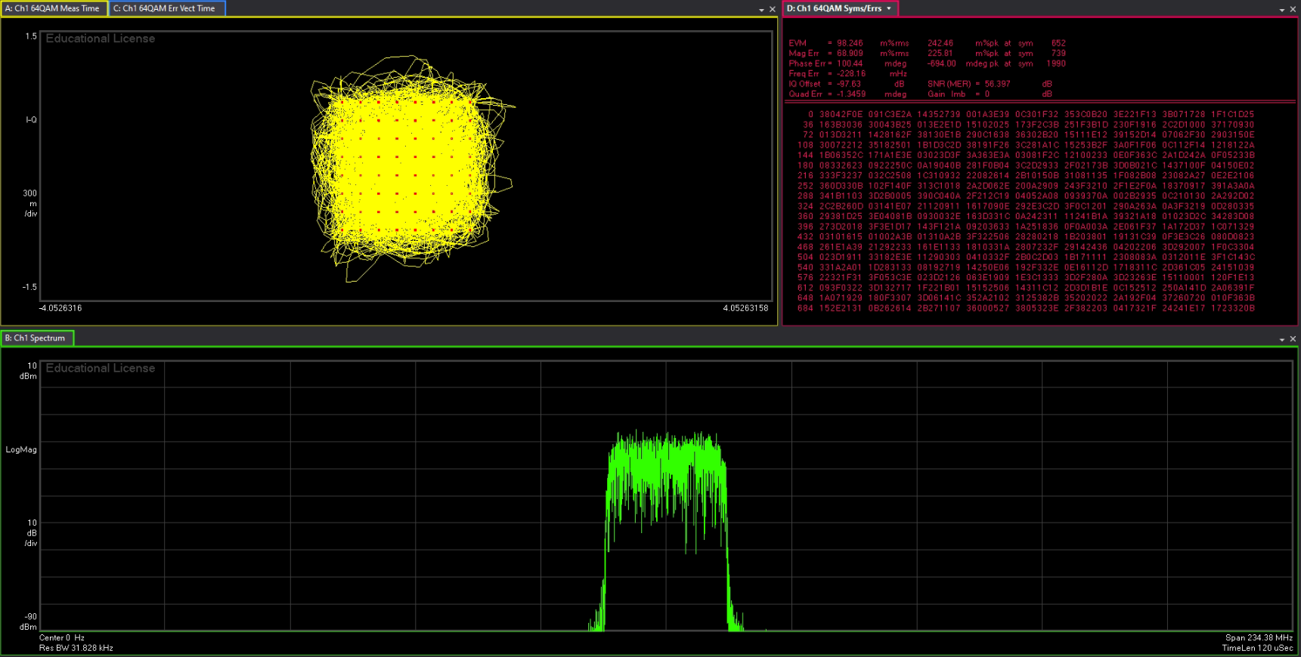
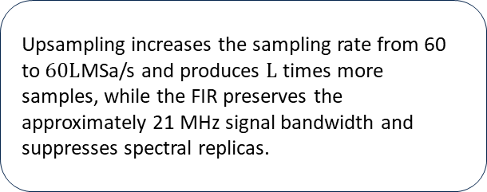
MATLAB - Anti-Imaging Filter (measured on Keysight VSA)
Same clean QAM-64 — but the FIR erases the image replicas
ORIGINAL INPUT 60 —MSa/s
FILTER OFF — image replicas remain
FILTER ON — replicas rejected
The original 64-QAM input contains one clean 20 MHz baseband channel with no interpolation images. EVM: 79 m%rms.
Spectrum shows the main band plus two side replicas — the images upsampling creates. EVM 91 m%rms.
The 10-tap FIRPM filter suppresses both side lobes — only the wanted band is left. EVM 98 m%rms.
Target: < 350m%rms | EVM [m%rms] Fixed Point (Q3.12) | Up-sampling Factor (L)
Pass | 116.21 | 2
Pass | 186.41 | 3
Pass | 192.94 | 4
Pass | 77.881 | 5
Upsampling increases the sampling rate from 60 to $60L$MSa/s and produces $L$ times more samples, while the FIR preserves the approximately 21 MHz signal bandwidth and suppresses spectral replicas.

Slide 7
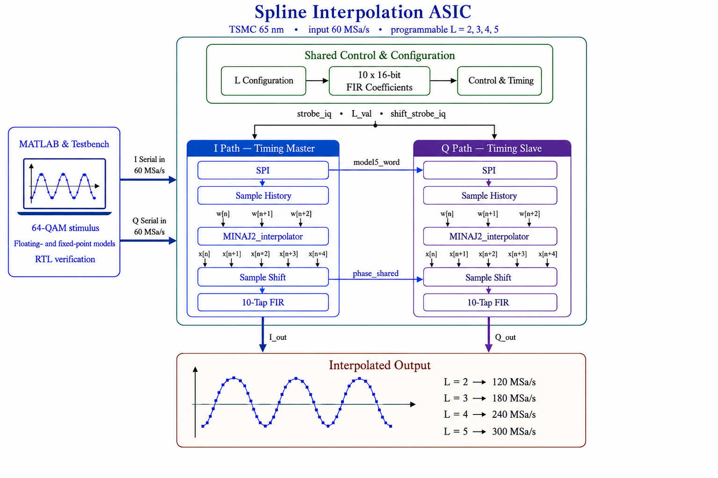
Architecture-RTL Design (Verilog)
How the MATLAB algorithm was translated into a programmable I/Q hardware datapath
Key architecture points
Two parallel I/Q datapaths
Same numerical chain for I and Q
I path = timing master
Provides word mode, strobes and phase
Q path = timing slave
Follows mode15_word and phase_shared
Programmable L = 2,3,4,5
Output rates: 120–300 MSa/s
Main idea: one shared control structure keeps both I and Q synchronized while supporting four programmable interpolation rates.

Slide 8
Architecture -Control and Multi-Rate Operation
Configuration, coefficient loading and L-dependent output scheduling
Startup sequence
RESET
Read L
Load FIR
coeff_done
I/Q Streami
clear state
sync + L[2:0]
10 coefficients
streaming enabled
MINAJ2 → FIR
Mode gating
Input sample event
Output sample event
coeff_load_mode = en_stream && !coeff_done
strobe_iq = 60 MHz
shift_strobe_iq = 60 × L MHz
en_iq = en_stream && coeff_done
New synchronized I/Q pair
Selects next interpolated sample
Mode table
L | word bits | bit clk | word rate | shift div | out rate
2 | 16 | 960 MHz | 60 MHz | 8 | 120 MHz
3 | 15 | 900 MHz | 60 MHz | 5 | 180 MHz
4 | 16 | 960 MHz | 60 MHz | 4 | 240 MHz
5 | 15 | 900 MHz | 60 MHz | 3 | 300 MHz
Why this timing works
960 MHz / 16 = 60 MHz | 900 MHz / 15 = 60 MHz
The design uses one external clock at a time. Multi-rate behavior is created by enables and strobes, not by generating extra clock domains.
Takeaway: configuration and coefficient loading are isolated from normal streaming; after coeff_done, one input pair produces exactly L filtered output samples.

Slide 9




Verification
Functional, formal & equivalence check — done
Functional
Formal
LEC - equivalence
VC Formal on major RTL blocks
Assertions/properties proven mathematically
Conformal: RTL ↔ synthesized netlist, and gate ↔ gate (top.v ↔ top_post_layout.v) before vs. after P&R.
Block-level and top-level simulation
MATLAB golden-model comparison
SystemVerilog Assertions (SVA)
Functional coverage
Corner cases and mode transitions
Verdi waveforms
Sign-off status
RTL sim
Formal (assertions)
Gate-level sim
LEC RTL↔gate

Slide 10
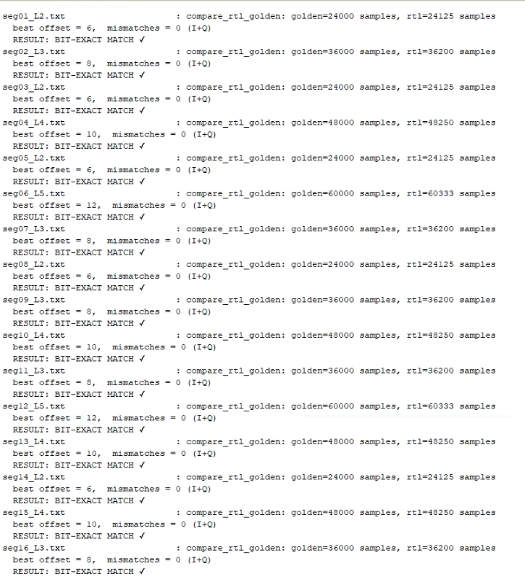
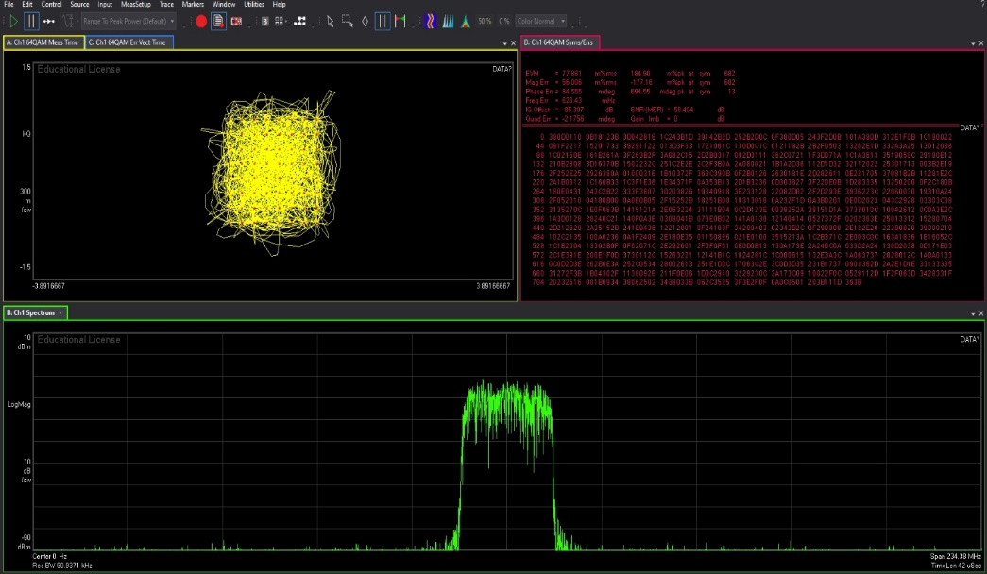
Functional Verification –GLS vs MATLAB Golden Model
MATLAB drives both paths; RTL must match the golden model bit-for-bit
MATLAB IQ tools
QAM I/Q +
FIRPM coeffs
Golden (fixed-point) model → Expected
Compare
bit-exact
+ VSA / EVM
RTL / gate sim (VCS) → Actual
Regression — RTL vs golden
VSA / EVM cross-check (Keysight)
Regression content
L = 2,3,4,5 • all 12 mode transitions • reset/configuration scenarios • zero/DC/impulse/full-scale/saturation cases
30 / 30
segments — 0 mismatches
Bit-exact on every L = 2–5 case (QAM + corner tests).
.

Slide 11
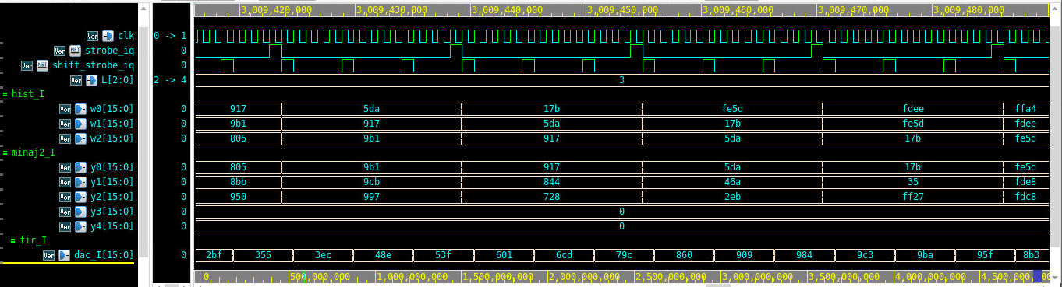
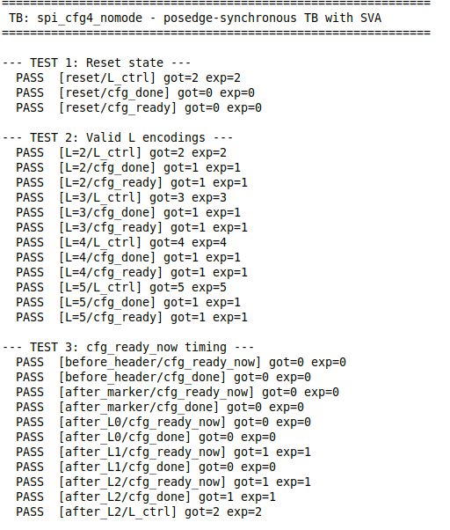
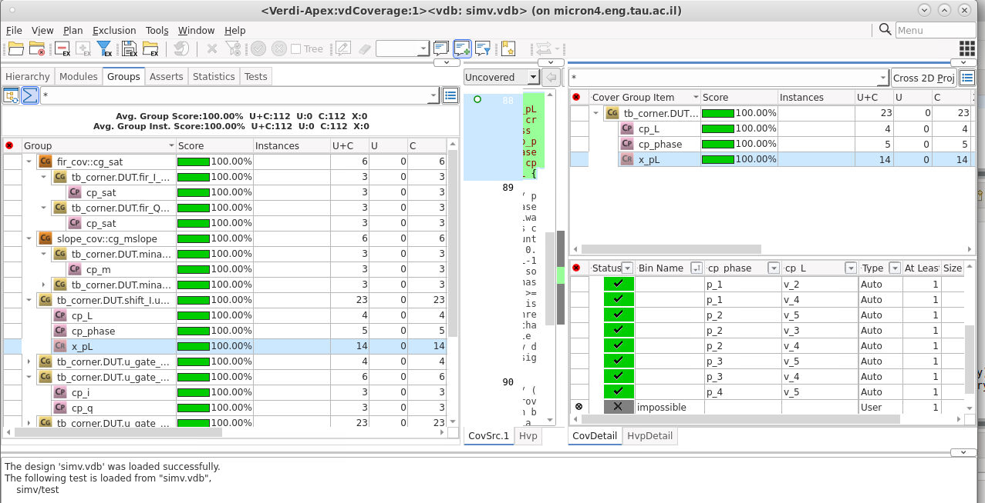
Functional Verification – WAVES · BLOCK TEST · COVERAGE
Waves : L = 3 · three samples y0–y2 per word· DAC out 180 MHz
What we check
Assertion checks
Configuration stability • legal strobe behavior • no I/Q processing before coeff_done • phase range/progression • saturation behavior
Coverage targets:
L modes • ordered mode transitions • coefficient loading • reset behavior • interpolation phases • saturation/corner cases
groups driven to 100% (no dead bins).
Each block: directed SVA test, 100% functional coverage
Block test – directed (SVA)
Functional coverage (top level) — 100%
cfg block: reset, all L, timing — all PASS

Slide 12
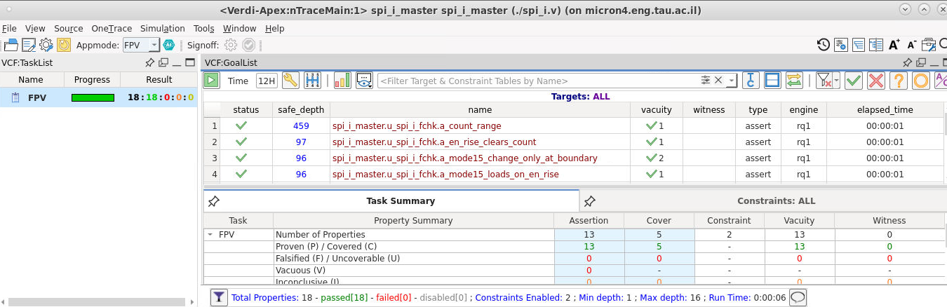
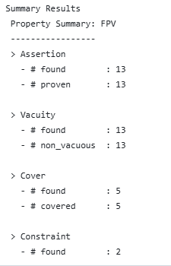
Formal Verification
Block-level formal verification of key RTL modules using assertions and cover properties.
Formal (VC Formal, FPV) –spi_i block
Spi_i block- formal results
Results
RTL blocks formally verified
123 assertions analyzed
118 assertions proven
5 assertions vacuous
0 failed assertions
38/38 cover properties reached
Vacuous properties:
The 5 vacuous assertions were reset-related properties whose triggering conditions did not occur under the formal constraints used in those runs. They were therefore classified as vacuous rather than failed.
What formal checked
Configuration logic • SPI word modes • history/window state • MINAJ2 arithmetic bounds • Sample Shift phase behavior • FIR coefficient/control behavior

Slide 13

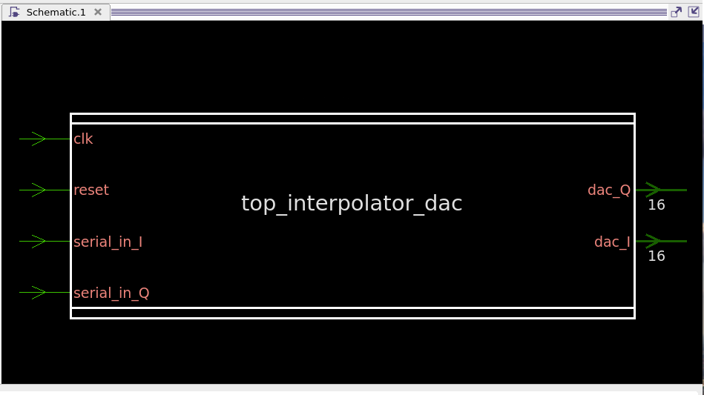
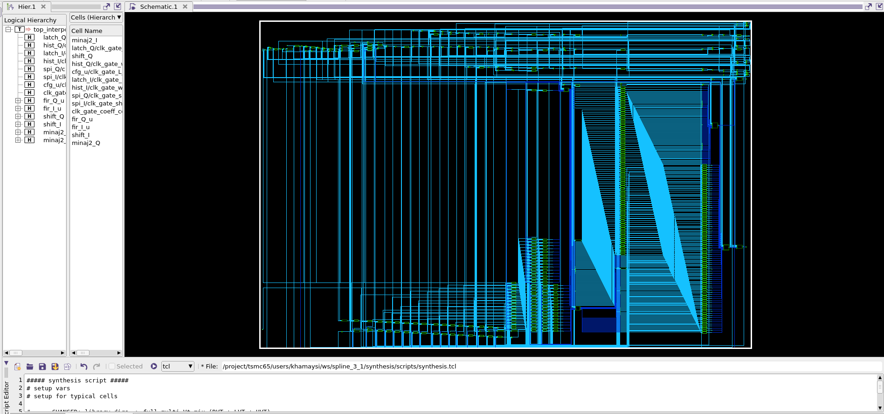

Synthesis (Synopsys DC)
High-frequency synthesis with multicycle constraints, clock gating, and technology mapping
Key SDC (real values)
Top-level block
Clock
Period: 1.0417 ns (960 MHz), 50% duty
Uncertainty :0.05 ns
Maximum transition : 0.20 ns
I/O timing
input/output delay 0.1 ns
Output load
0.05 pF
Multicycle
Word-rate regs -15 cyc setup / 14 cyc hold
FIR MAC regs -3 cycles setup / 2 cycles hold
Clock Gating
Latch-based clock gating, minimum bit-width 3
Cells
HVT-first for leakage; LVT only where timing needs it
Synthesized gate netlist
Multicycle path — the key move
The 10-tap MAC is the deepest combinational cloud, but its result is only sampled every ≥3 clocks (shift_strobe).
Two multicycle groups: 15/14-cycle on the interpolator & window-latch regs (they update once per ~15-16-clock word), and 3/2-cycle on the FIR y-regs.
Synthesis then avoids over-sizing: smaller, HVT-heavy MAC → lower area & power at the same function.
13

Slide 14
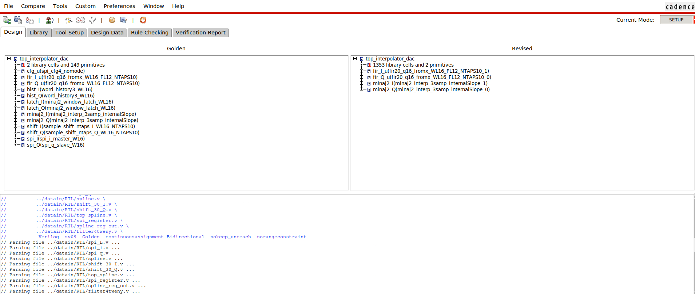
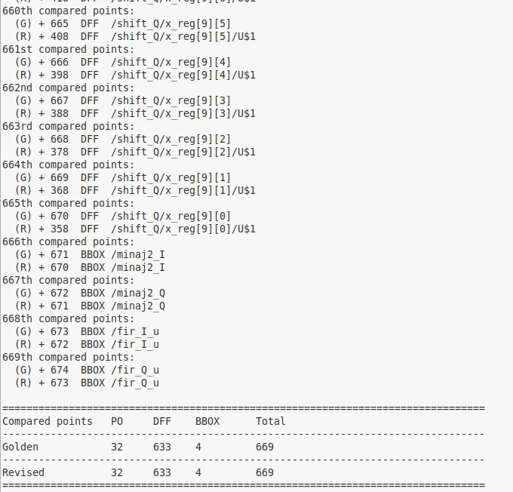
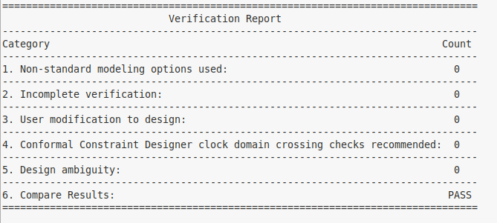
LOGICAL EQUIVALENCE –LEC (CADENCE CONFORMAL)
RTL golden vs synthesized netlist — all points mapped and proven equivalent
Golden (RTL) vs Revised (netlist)
Compared points — 669
Verification Report
669 compared points — all equivalent
32 primary outputs + 633 DFFs + 4 black-boxes; Golden = Revised.
Verification Report: PASS — 0 non-standard options · 0 incomplete · 0 ambiguity · 0 aborts.
Synthesized netlist proven equivalent to the RTL.

Slide 15
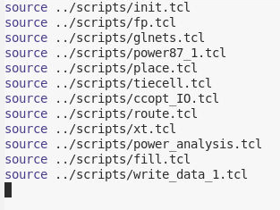
Physical Design (Cadence Innovus)
From synthesized netlist to routed and extracted pad-level ASIC implementation
Floorplan
Power Plan
Placement
CTS
Routing
Extraction
Die · core · pads
Rings · stripes
Timing · congestion
Clock tree
Timing · SI · ECO
SPEF for STA
Flow driver (full.tcl)
Implementation setup
Pad-level netlist · MMMC timing views · SDC constraints
TSMC 65 nm LEF / technology setup · design handoff files
Backend objective
Create a legal routed pad-level layout
Meet routing, timing, power and signoff requirements
Export final netlist, SPEF and layout data
Final target: routed pad-level ASIC with extracted parasitics ready for PrimeTime, power and DRC/ LVS signoff

Slide 16
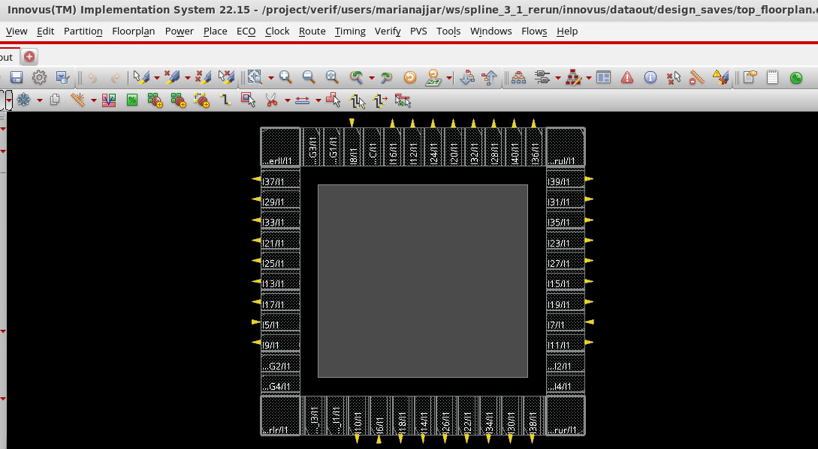
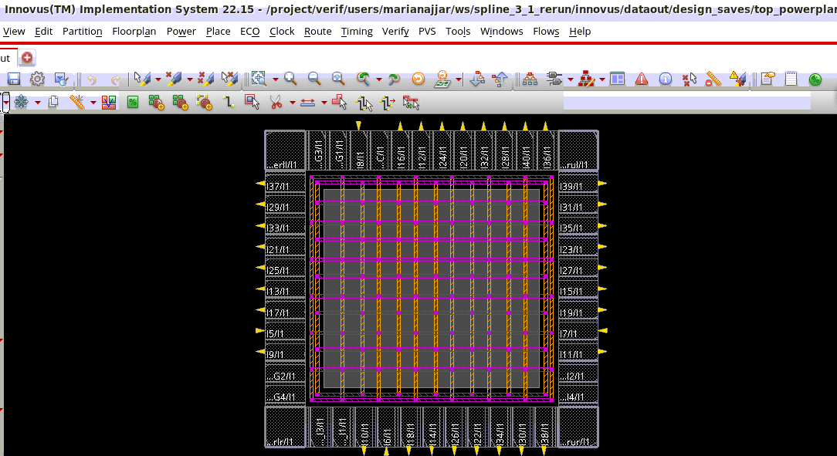
Floorplan & Power Distribution
Pad frame, core area and VDD/VSS network prepared before placement
Die + pad ring (Innovus)
Power mesh over the core
Floorplan
Power Network
• Die: 1000 × 950 µm (0.95 mm²)
• VDD/VSS rings connected to pads
M7 top/bottom, M6 left/right, width 10.
• Core: 646 × 596 µm (≈0.385 mm²)
• Pad frame around the digital core
• Horizontal and vertical straps above the core
M6 vertical + M7 horizontal, width 10, space 50, pitch 110.
• Standard-cell rail connection and stacked vias (M1 → M7 )
• Sufficient margin for routing and power delivery
• Rail analysis used to guide PDN improvements

Slide 17
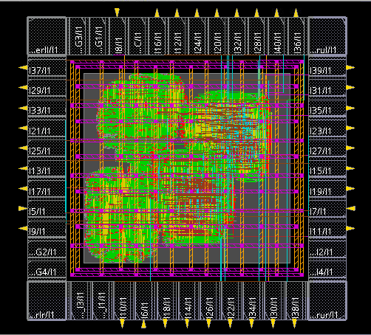
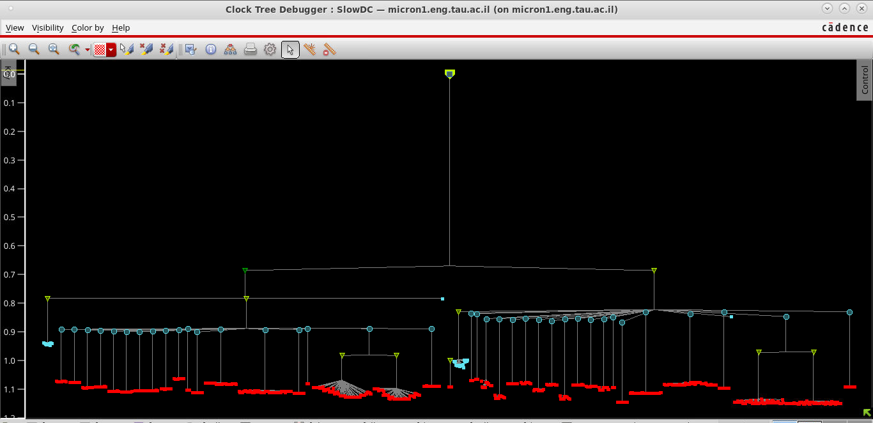
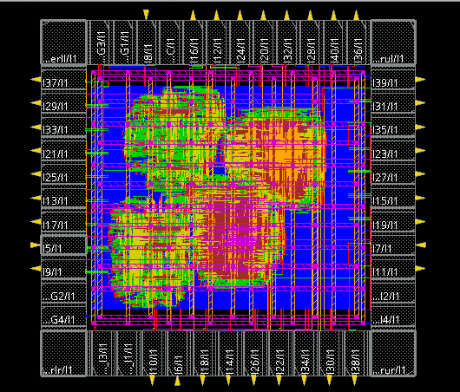
Placement, Clock Tree & Routing
Implementation closure through timing-aware placement, CCOpt CTS and detailed routing
Placement
Clock Tree Synthesis
Routing
Key checks
Key checks
Key checks
• Timing- and congestion-driven
• Clock-gating aware optimization
• 0 unplaced instances
• Power-driven maxDensity 0.5
• Core Utilization 38%
• Clock distributed from input pad
• 1,063 clock sinks
• Skew and insertion optimized
• Timing- and SI-aware route
• Post-route optimization
• SPEF extraction for signoff
Result: routed design with extracted parasitics for final timing and power analysis

Slide 18
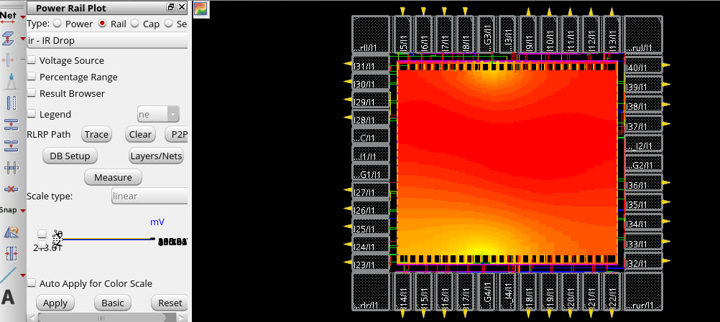
Post-Route Power Analysis
SAIF-based Innovus power reports for each interpolation factor and analysis view
Total Pad-Level Design Power
Core Power
]mW[
]mW[
L | SlowView | TypView | FastView
2 | 93.204 | 80.703 | 128.525
3 | 112.566 | 103.597 | 155.429
4 | 115.263 | 107.006 | 159.500
5 | 117.161 | 109.509 | 162.620
L | SlowView | TypView | FastView
2 | 16.32 | 19.53 | 24.24
3 | 20.78 | 25.04 | 30.84
4 | 24.47 | 29.62 | 36.27
5 | 28.75 | 34.89 | 42.63
Key observation
Rail Integrity
As L increases, the output datapath toggles more frequently. The pad-level total includes I/O and support circuitry; I0 isolates the interpolation core.
Rail summary
Grid connectivity: Clean - 0 violations and 0 warnings
Static IR drop — Slow view Maximum VDD drop: 189.1 mV Maximum VSS ground rise: 213.6 mV
The power grid is fully connected, but localized voltage drop indicates that the PDN should be strengthened in future work.
SAIF-based estimation
Annotation
75.37%
Pswitching ≈ Σ αᵢ · Cᵢ · V² · f
SAIF supplies αᵢ: realistic toggle counts and logic-state probabilities from gate-level simulation.
Power increases with L; power-grid connectivity passed, while IR-drop analysis identified PDN strengthening as the main improvement.

Slide 19
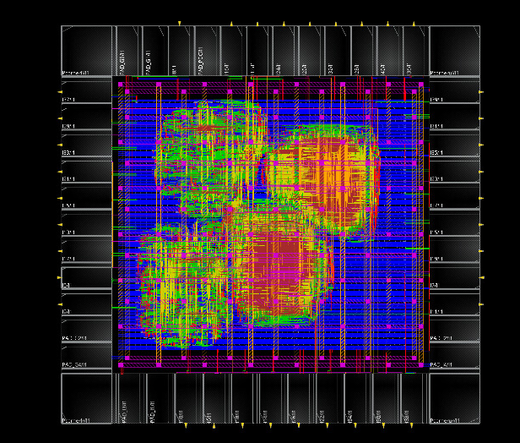
Post Layout STA — PrimeTime
Filler and Decap Cells
Physical finishing step before extraction, STA and final signoff
Corners Checked
Check | Corner / View | Purpose | Final WNS
Setup | Slow corner / Max delay | Worst-case data-path delay | +0.29 ns — MET
Hold | Fast corner / Min delay | Worst-case short-path delay | +0.86 ns — MET
Typical | Typical view | Sanity / consistency check | No signoff violation reported
Methodology: PrimeTime used the post-layout netlist, extracted SPEF, timing libraries and final SDC constraints with propagated clocks.
Utilization
Why are they inserted?
Fill unused gaps between standard cells after routing/ECO.
Functional cells only
38.77%
100%
Keep well continuity and continuous VDD/VSS rails across rows.
Takeaway: the routed ASIC meets final setup and hold timing after parasitic extraction.
Including fillers
Decap cells add local capacitance to help stabilize the supply.

Slide 20
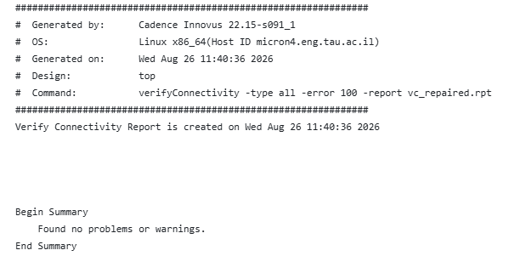
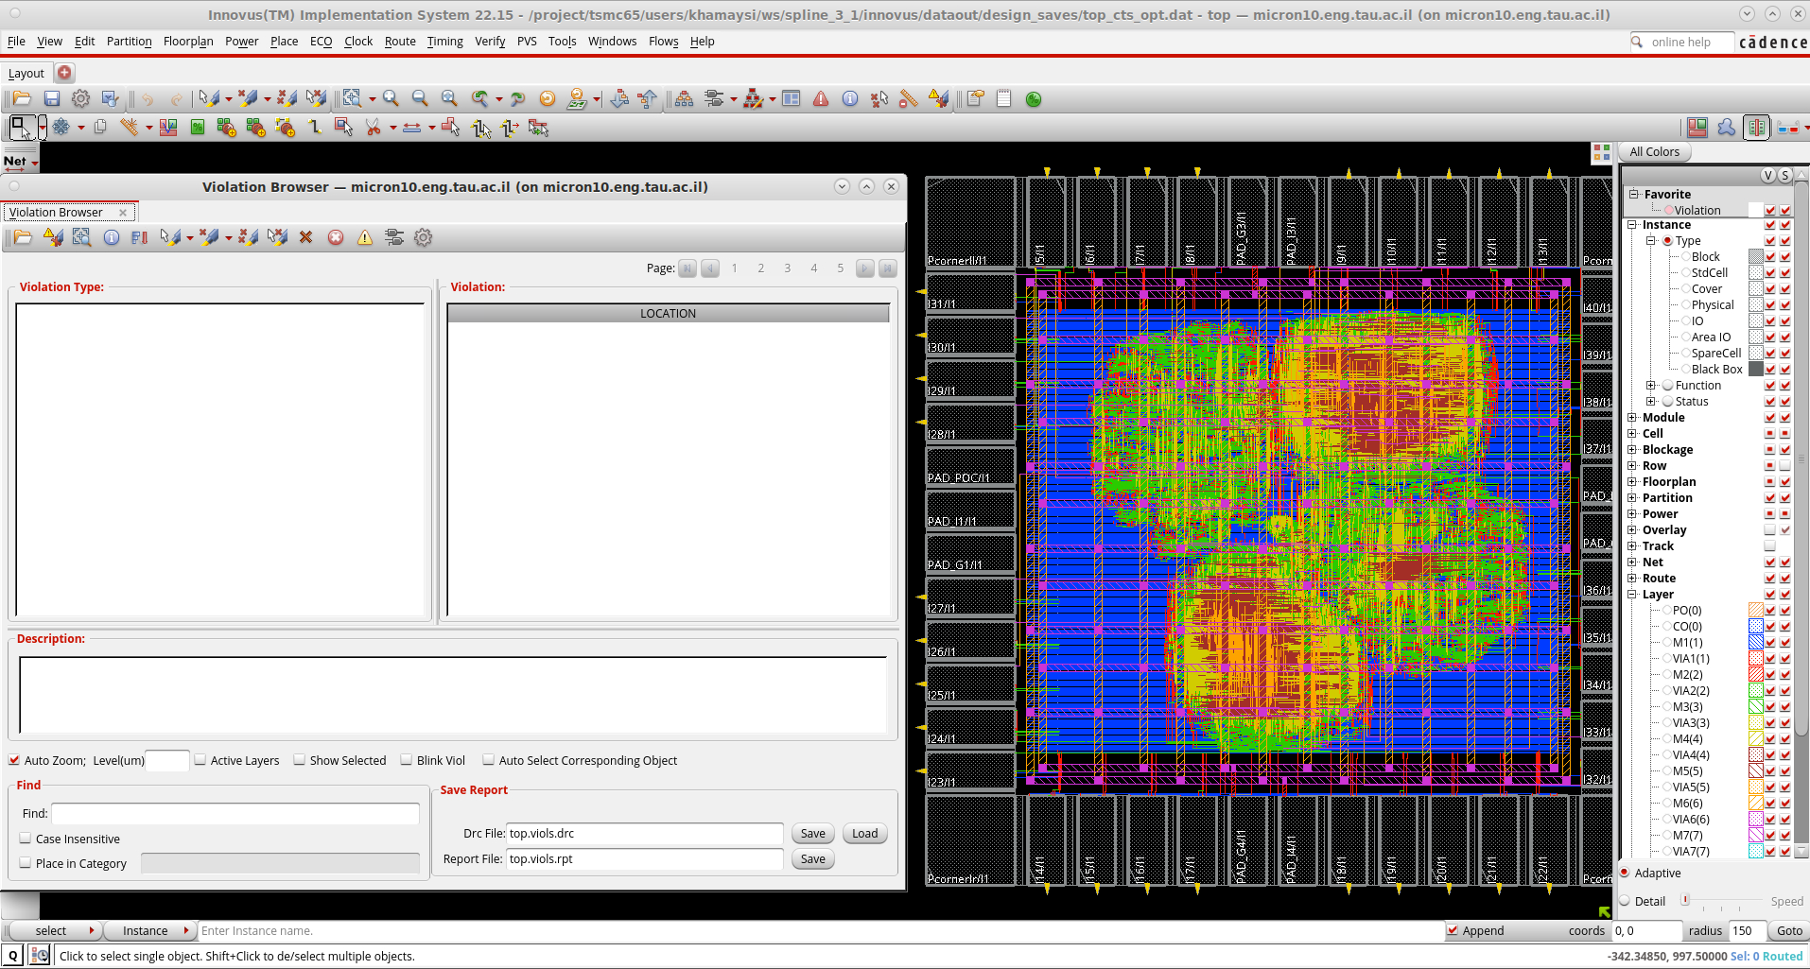
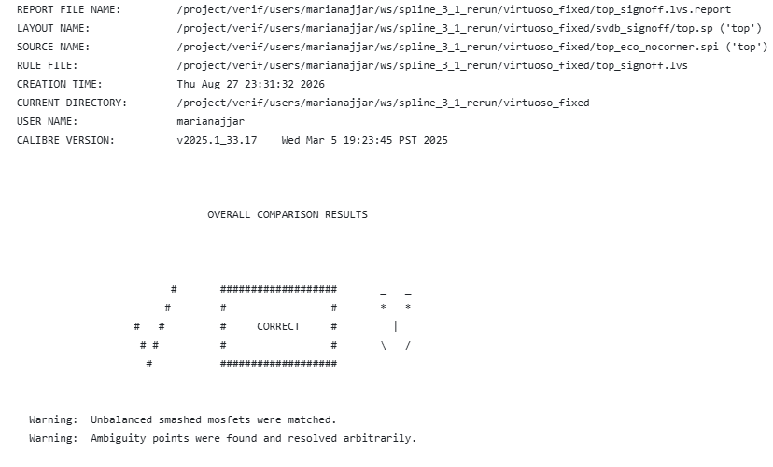
Physical Verification — DRC & LVS
Calibre and Innovus checks used to validate geometry, connectivity and extracted layout equivalence
Connectivity Report
DRC Result
LVS Report
LVS: extracted layout netlist (top.sp) vs. reference SPICE netlist (top_eco_nocorner.spi)
0 violations
PASS
CORRECT
Reviewed
Innovus DRC
Connectivity
Calibre LVS
Calibre DRC
implementation-level checks
no problems / warnings
layout vs. source
pad / technology checks
DRC/LVS note
Innovus geometry/connectivity checks were clean. Calibre LVS reports CORRECT. Remaining Calibre DRC markers are mainly pad/ESD or technology/fill related and were reviewed within the academic project scope.

Slide 21
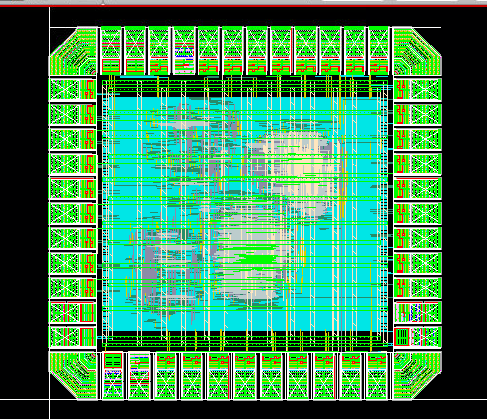
Final Post-Layout Results
Summary of routed ASIC metrics and signoff evidence
Final Layout view
Final Metrics
Metric | Final Result
Technology | TSMC 65 nm LP
Interpolation modes | L = 2, 3, 4, 5
Output rate | 120–300 MSa/s
Die area | 0.95 mm²
Core area | 0.385 mm²
Core utilization | 38.77% functional / 100% with fillers
Final slack | Setup : +0.29 ns / Hold :+0.86 ns
Typical power @ L=5 | 109.51 mW full chip / 34.89 mW core
Physical verification | Innovus DRC: clean; Calibre LVS: CORRECT; remaining DRC exceptions reviewed.
Final Signal Quality Results
Up-sampling factor (L) | MATLAB EVM [m%rms] | RTL EVM [m%rms] | Requirement Target: < 350m%rms
2 | 116.21 | 110.00 | Pass
3 | 186.41 | 174.88 | Pass
4 | 192.94 | 186.37 | Pass
5 | 77.88 | 72.80 | Pass
Main Handoff Files
Post-layout Verilog netlist • extracted SPEF files • final reports • LVS/DRC evidence • power-analysis reports
Final outcome: routed, timed, power-characterized and physically checked pad-level ASIC implementation

Slide 22
Future Work & Project Repository
Next steps for improving the spline interpolation ASIC and preserving the complete project flow
Future Work
< >
Project Repository
Power-Delivery Improvement :Strengthen the PDN with additional VDD/VSS pads and improved power routing.
FPGA Prototyping: Validate the full architecture in real time at a reduced/scaled operating frequency.
DFT & ATPG Extension: Add scan chains, then generate stuck-at/transition patterns and evaluate fault coverage.
Architecture Extension: Architecture Extension
Spline_ASIC
https://github.com/marianajjar/Spline_ASIC.git
Repository includes
MATLAB models · RTL · Verification Synthesis & Innovus scripts · Reports · Documentation

